Slide 1
Correlation & Regression

Slide 2
Introduction
In previous chapters we have introduced two areas of inferential statistics, hypothesis testing & Confidence intervals.
Another area of inferential statistics involves determining whether a relationship between two or more numerical or quantitative variables exists. For example:
A businessperson may want to know whether the volume of sales for a given month is related to the amount of advertising the firm does that month.
Educators are interested in determining whether the number of hours a student studies is related to the student’s score on a particular exam.
Medical researchers are interested in questions such as “Is caffeine related to heart damage?” or “Is there a relationship between a person’s age and his or her blood pressure?”
A zoologist may want to know whether the birth weight of a certain animal is related to its life span.

Slide 3
Introduction (Contd.)
These are only a few of the many questions that can be answered by using the techniques of correlation and regression analysis.

Slide 4
Correlation is a statistical method used to determine whether a relationship between variables exists.
The purpose of this chapter is to answer the following questions statistically:
1. Are two or more variables related?
2. If so, what is the strength of the relationship?
3. What type of relationship exists?
4. What kind of predictions can be made from the relationship?
Introduction

Slide 5
In simple correlation and regression studies, the researcher collects data on two numerical or quantitative variables to see whether a relationship exists between the variables. For example:
if a researcher wishes to see whether there is a relationship between number of hours studied and test scores on an exam as shown:
Introduction

Slide 6
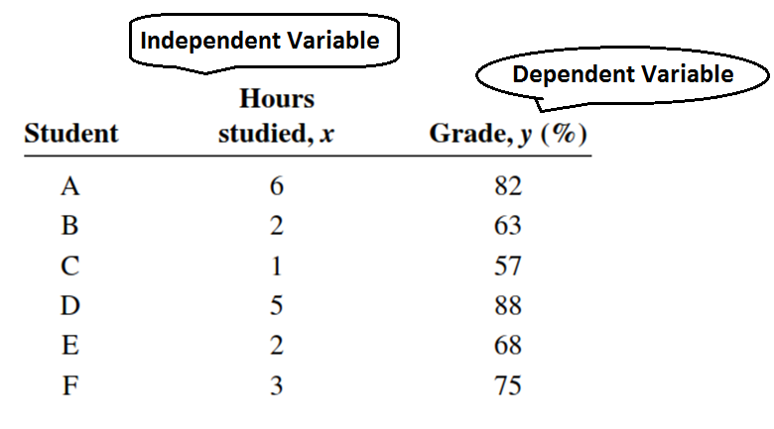
The independent variable is the variable in regression that can be controlled or manipulated.
The dependent variable is the variable in regression that cannot be controlled or manipulated.
Introduction

Slide 7
Scatter Plot
The independent and dependent variables can be plotted on a graph called a scatter plot. The independent variable, x, is plotted on the horizontal axis and the dependent variable, y, is plotted on the vertical axis.

Slide 8
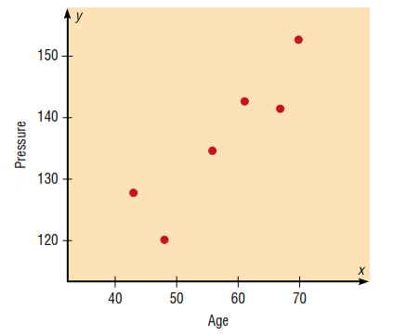
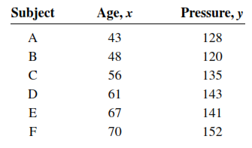
Scatter plot (Example 01)
Construct a scatter plot for the data obtained in a study of age and systolic blood pressure of six randomly selected subjects. The data are shown in the following table.

Slide 9
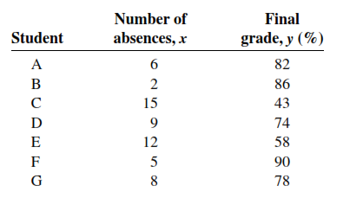
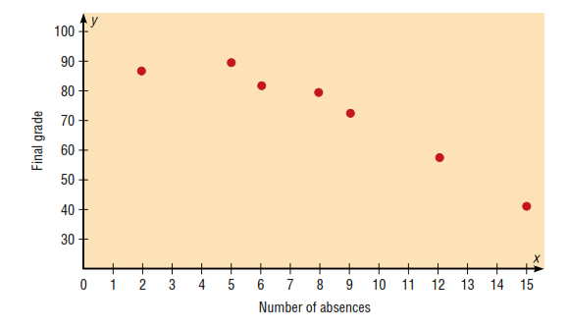
Scatter plot (Example # 02)
Construct a scatter plot for the data obtained in a study on the number of absences and the final grades of seven randomly selected students from a statistics class.

Slide 10
Correlation Coefficient
to determine the strength of the relationship between two variables. There are several types of correlation coefficients. The one explained in this section is called the Pearson product moment correlation coefficient (PPMC), named after statistician Karl Pearson, who pioneered the research in this area.
The correlation coefficient computed from the sample data measures the strength and direction of a linear relationship between two variables. The symbol for the sample correlation coefficient is r. The symbol for the population correlation coefficient is ρ (Greek letter rho).
Correlation

Slide 11
Properties of Correlation Coefficient
Correlation coefficient is symmetric rxy = ryx.
Correlation coefficient does not depend on units.
The correlation coefficient lies between – 1 to + 1 i.e. – 1 ≤ r ≤ +1
Correlation

Slide 12
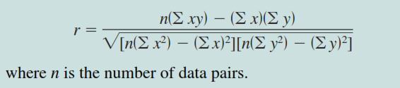
Formula for Correlation Coefficient
Correlation

Slide 13
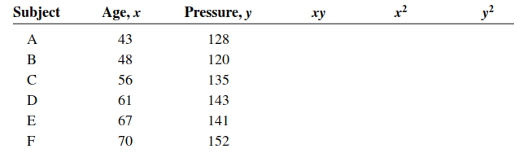
Example # 03
Compute the value of the correlation coefficient for the data obtained in the study of age and blood pressure:
Correlation
Notes:
Sum(x) = 345; sum(y) = 819;; sum(xy)=47634; Sum(x^2)=20399; Sum(y^2)=112443
R=0.897🡪Strong Positive correlation

Slide 14
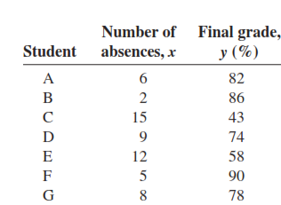
Example # 04
Compute the value of the correlation coefficient for the data obtained in the study of the number of absences and the final grade of the seven students in the statistics class:
Correlation
Notes:
Sum(x) = 57; Sum(y)=511; Sum(xy)=3745; Sum(x^2)=579; Sum(y^2)=38993
R= - 0.944

Slide 15
The Significance of Correlation
Since the value of r is computed from data obtained from samples, there are two possibilities when r is not equal to zero: either the value of r is high enough to conclude that there is a significant linear relationship between the variables, or the value of r is due to chance.
In order to make this decision, one uses a hypothesis-testing procedure.
Correlation

Slide 16
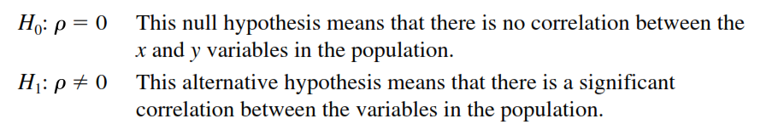
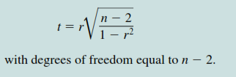
Hypothesis testing for Correlation
Correlation

Slide 17
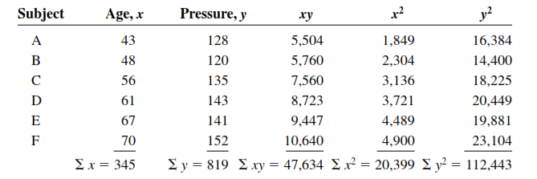
Example # 05
Test the significance of the correlation coefficient found in Example # 01.
Correlation
Notes:
R=0.897

Slide 18


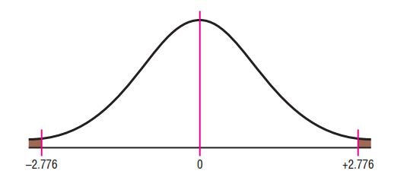
Example # 05 (Contd.)
Correlation

Slide 19
Possible relationship b/w variables
When the null hypothesis has been rejected for a specific value, any of the following possibilities can exist.
There is a direct cause-and-effect relationship between the variables. That is, x causes y. For example, water causes plants to grow, poison causes death, and heat causes ice to melt.
There is a reverse cause-and-effect relationship between the variables. That is, y causes x. For example, suppose a researcher believes excessive coffee consumption causes nervousness, but the researcher fails to consider that the reverse situation may occur. That is, it may be that an extremely nervous person craves coffee to calm his or her nerves.
The relationship between the variables may be caused by a third variable.
Remember, correlation does not necessarily imply causation.
Correlation

Slide 20
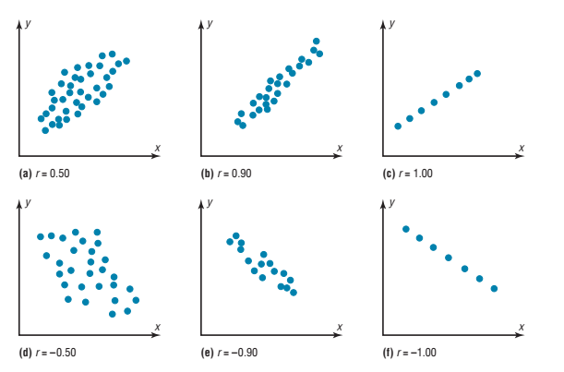

Slide 21
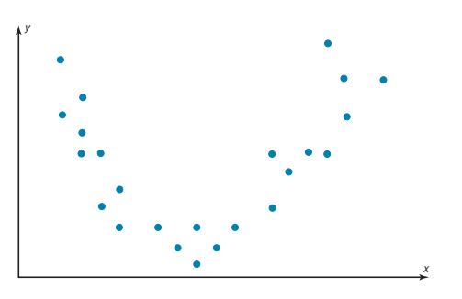
Curvilinear relationship

Slide 22
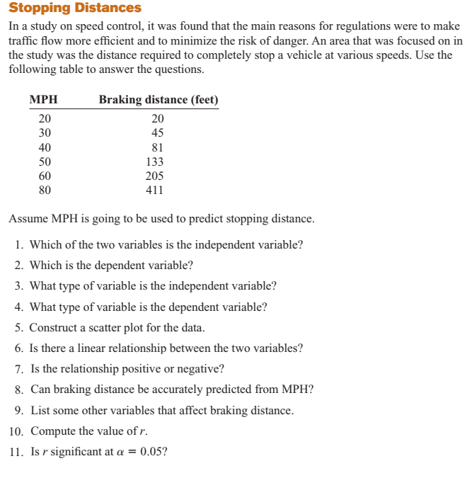
Notes:
Case study

Slide 23
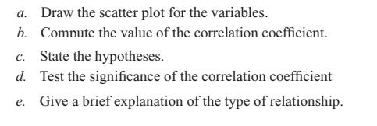
Do the following for next 3 slides

Slide 24
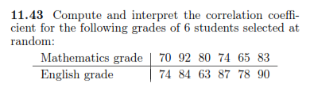

Practice Questions for Correlation
Correlation

Slide 25

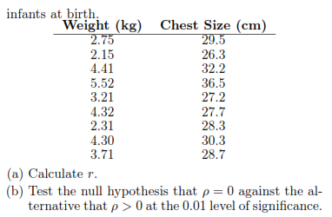
Practice Questions for correlation (Contd.)
Correlation

Slide 26
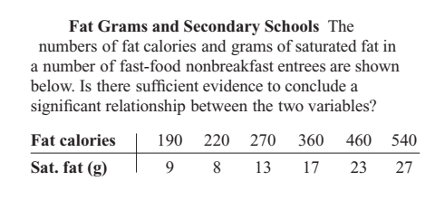

Slide 27
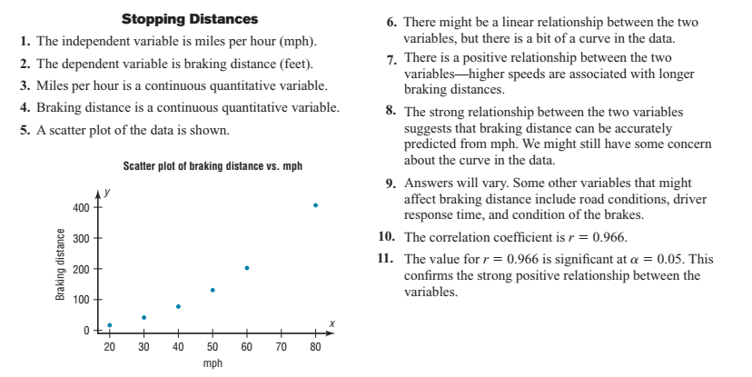

Slide 29
Simple Linear Regression
In studying relationships between two variables:
collect the data and then construct a Scatter plot.
compute the value of the correlation coefficient.
test the significance of the relationship.
If the value of the correlation coefficient is significant, the next step is to determine the equation of the regression line, which is the data’s line of best fit.
Determining the regression line when r is not significant and then making predictions using the regression line is meaningless.

Slide 30
Simple Linear Regression (Contd.)
The dependence of one variable over the other variable is called “Regression”.
The statistical method which helps us to estimate the value of dependent variable from the known value of independent variable is called regression.
Simple Linear Regression

Slide 31

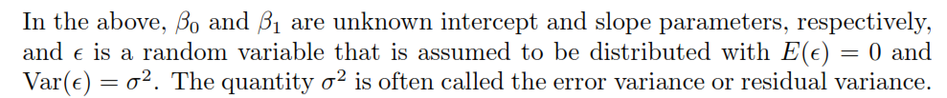
Simple Linear Regression Model
The statistical model for simple linear regression is given below. The response Y is related to the independent variable x through the equation:
Simple Linear Regression

Slide 32

The quantity Y is a random variable since is ϵ random.
The value x of the regressor variable is not random and, in fact, is measured with negligible error.
The quantity ϵ, often called a random error or random disturbance, has constant variance (homogeneous variance).
The presence of this random error, , keeps the model from becoming simply a deterministic equation.
Simple Linear Regression

Slide 33
We must keep in mind that:
in practice ß0 and ß1 are not known and must be estimated from data.
we never observe the actual ϵ values in practice and thus we can never draw the true regression line
We can only draw an estimated line.
Simple Linear Regression

Slide 34
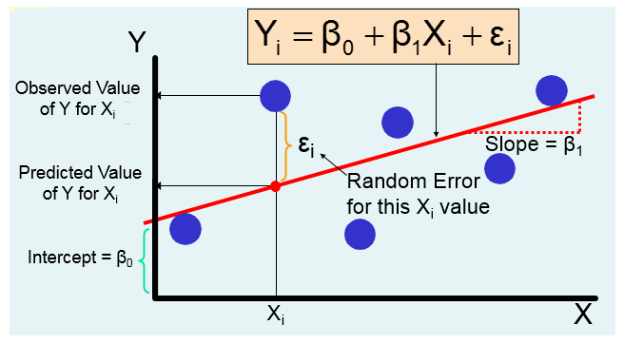
Simple Regression Model (Contd.)

Slide 35
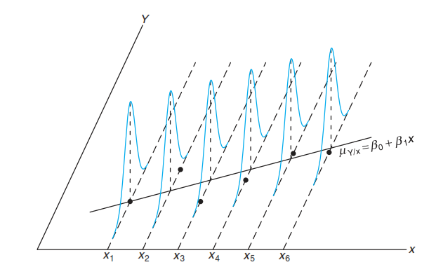
Assumptions of Regression Model

Slide 36
Deterministic Vs. Statistical Relationship
in regression analysis we are concerned with what is known as the statistical, not deterministic dependence among variables.
In statistical relationships among variables we essentially deal with random or stochastic variables i.e. variables that have probability distributions.
Simple Linear Regression

Slide 37

Deterministic Vs. Statistical (Example)
The dependence of crop yield on temperature, rainfall, sunshine, and fertilizer, for example, is statistical in nature in the sense that the explanatory variables, although certainly important, will not enable the agronomist to predict crop yield exactly.
In deterministic phenomena, on the other hand, we deal with relationships of the type, say, exhibited by Newton’s law of gravity, which states: Every particle in the universe attracts every other particle with a force directly proportional to the product of their masses and inversely proportional to the square of the distance between them.
Simple Linear Regression

Slide 38
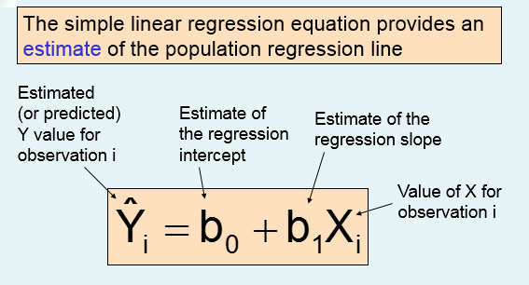
Simple Linear Regression

Slide 39
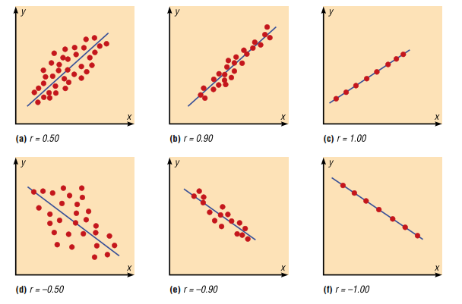

Relationship B/w Regression & Correlation
The value of the correlation coefficient can also be found by using the formula:

Slide 40
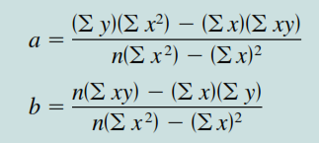
Determining Regression Equation
There are several methods for estimating the regression parameters, here we will use Method of Least Sq. to estimate the parameters.
The formula for parameters estimation by least square is given below:
Simple Linear Regression

Slide 41
The Method of Least Squares
We shall find b0 and b1, so that the sum of the squares of the residuals is a minimum.
The residual sum of squares is often called the sum of squares of the errors about the regression line and is denoted by SSE.
This minimization procedure for estimating the parameters is called the method of least squares.
Simple Linear Regression

Slide 42
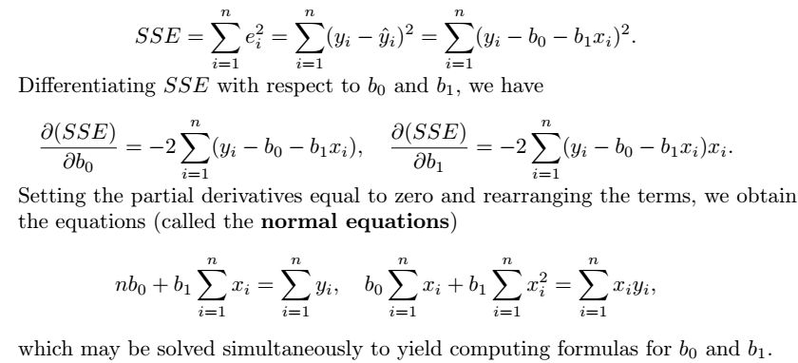
The Method of Least Squares (Contd.)
We have considered bo = a & b1 = b (see slide 38)
Simple Linear Regression

Slide 43
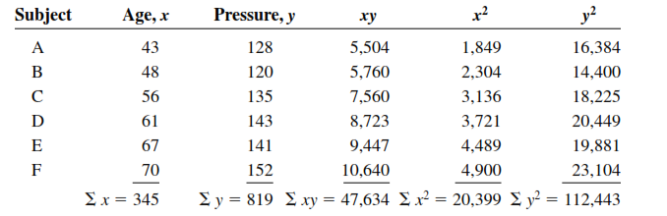
Example # 06
Find the equation of the regression line for the data in Example # 01 (Slide 15), and graph the line on the scatter plot of the data.

Slide 44
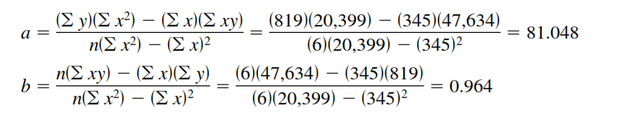

Example # 06 (Contd.)
The sign of the correlation coefficient and the sign of the slope of the regression line will always be the same. The reason is that the numerators of the formulas are the same.
Simple Linear Regression

Slide 45
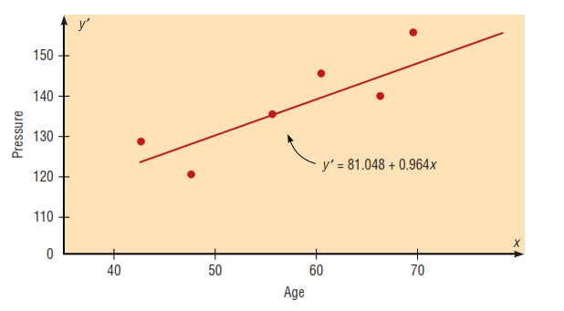
Simple Linear Regression

Slide 46
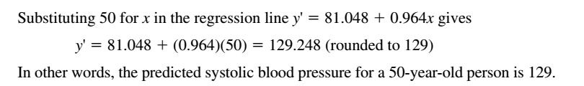
Prediction Using Regression Eq.
Using the equation of the regression line found in Example # 06, predict the blood pressure for a person who is 50 years old.
Simple Linear Regression

Slide 47
Assumptions for valid prediction
For any specific value of the independent variable x, the value of the dependent variable y must be normally distributed about the regression line.
The standard deviation of each of the dependent variables must be the same for each value of the independent variable.
Simple Linear Regression

Slide 48
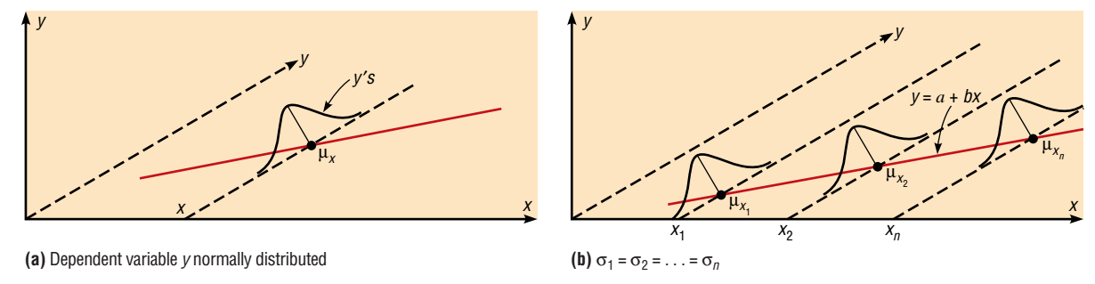
Assumptions for Prediction
Simple Linear Regression

Slide 49
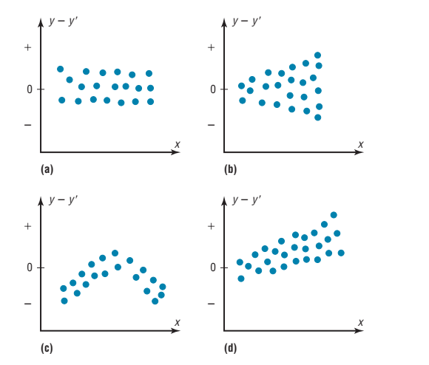
Residual Analysis
To interpret a residual plot, you need to determine if the residuals form a pattern.
All showing pattern.
Model is not good

Slide 50
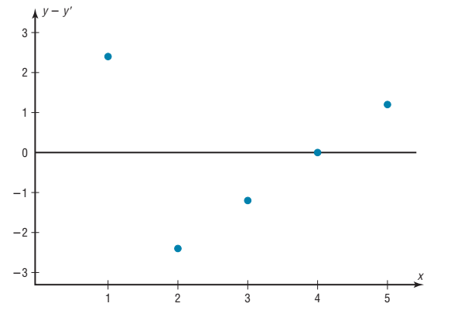
The residual plot shows that the regression line y = 4.8 + 2.8*x is
somewhat questionable for making predictions due to a small sample size.

Slide 51

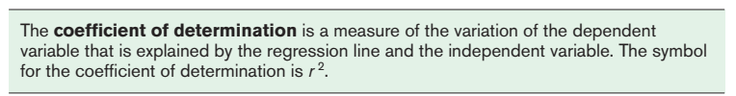
Coefficient of Determination (r2)

Slide 52
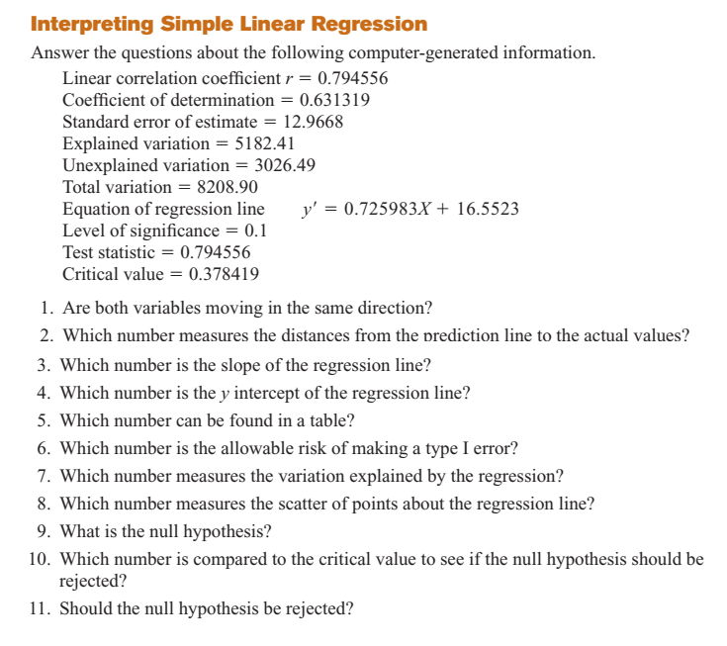

Slide 53
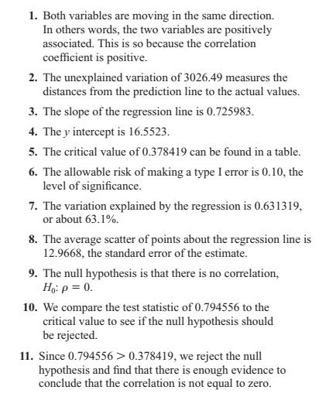

Slide 54
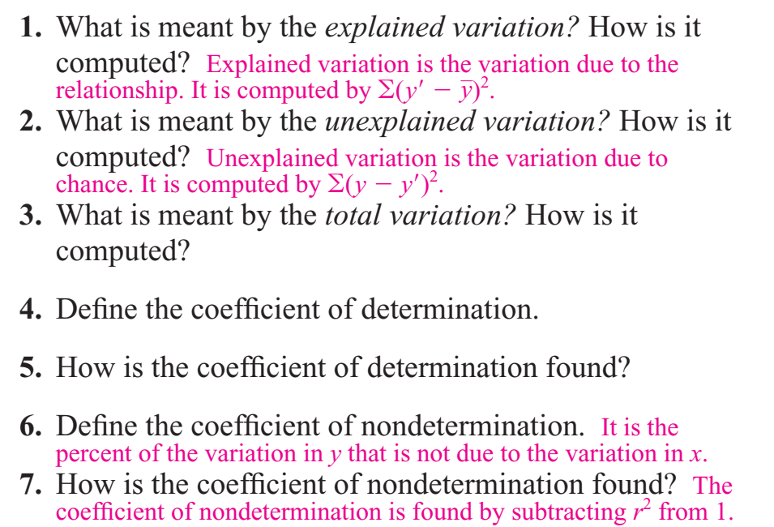
Short Q/A

Slide 55
Example # 07
Consider the experimental data given below, which were obtained from 33 samples of chemically treated waste in a study conducted at Virginia Tech. Readings on x, the percent reduction in total solids, and y, the percent reduction in chemical oxygen demand, were recorded. Estimate the regression line for the pollution data.
Simple Linear Regression

Slide 56
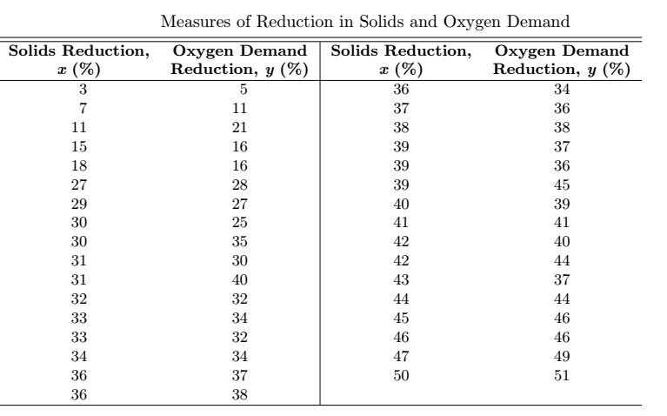

Example # 07 (Contd.)
Simple Linear Regression

Slide 57
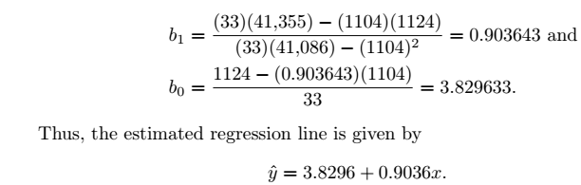
Example # 07 (Contd.)
Simple Linear Regression

Slide 58
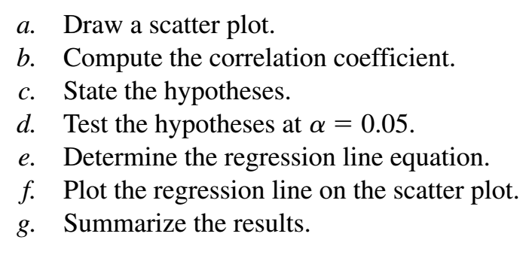
Practice questions
Do a complete regression analysis by performing the following steps for Q1 & Q2. (See Next Slide)
Simple Linear Regression

Slide 59
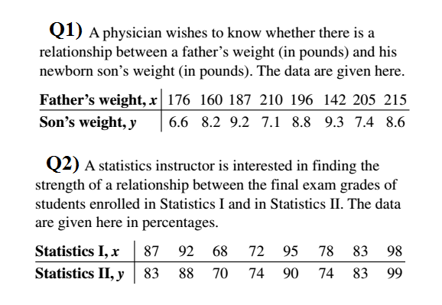
Simple Linear Regression

Slide 60
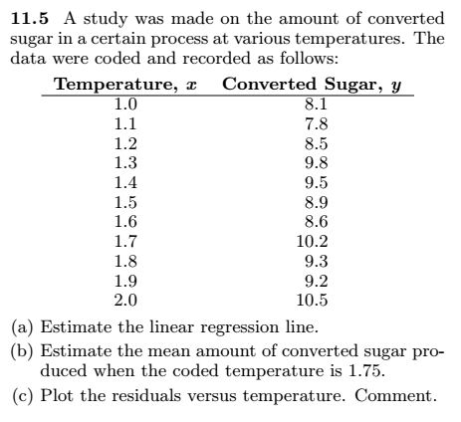
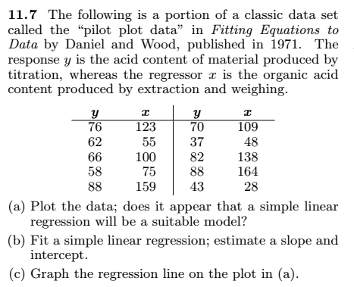
Practice Questions
Simple Linear Regression

Slide 61
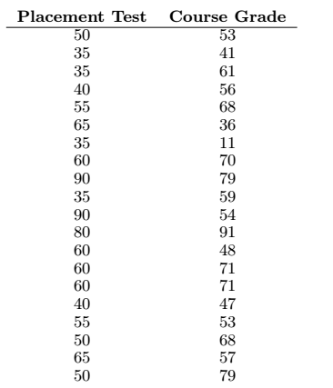
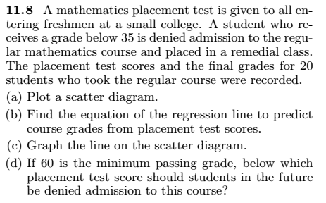
Practice Questions
Simple Linear Regression

